Slide 1
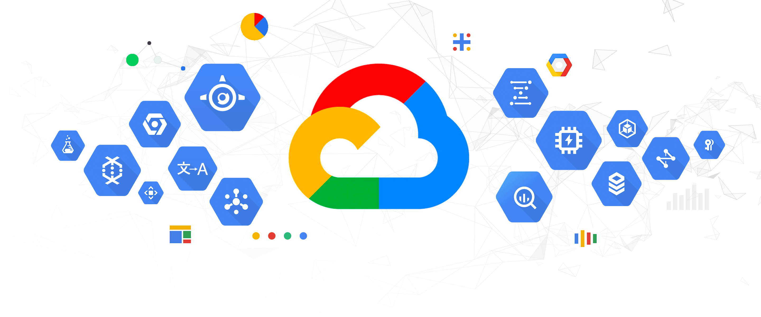
Strategic Cloud Transformation
Empowering Rapid Growth with GCP Solutions
By,
K R Madhumitha

Slide 2
Problem Statement
Challenges and Imperatives
Current Scenario:
On-premise infrastructure faces limitations.
Anticipated rapid growth in application traffic.
Challenges:
Capacity constraints hindering scalability.
Security concerns in the on-premise environment.
Limited availability impacting business continuity.
Imperatives:
Immediate need for a scalable and secure solution.
High availability to meet growing traffic demands.
Transition to a resilient cloud architecture for future-proofing.
Solution Goals:
Scalability
Security
High Availability
Rapid Adaptability to Growth

Slide 3
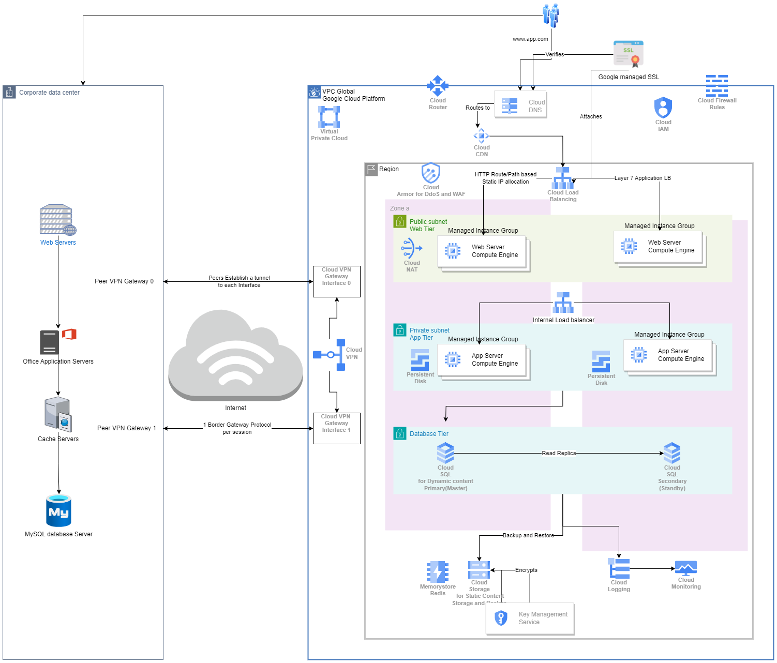
Architecture Solution

Slide 4
Architecture Overview
High-Level Design
Networking and Connectivity:
Virtual Private Cloud (VPC) spanning 2 zones in 1 region.
VPN connection with 2 interfaces for on-premise to cloud migration.
Cloud Router for dynamic route exchanges.
Cloud DNS for Domain Management and Resolution.
Web Tier(Front End):
Managed Instance Group (MIG) of web servers in a public subnet.
Cloud NAT for outbound internet access.
Cloud Armor for web application firewall protection.
Google-managed SSL certificates for secure communication.
Cloud CDN for content delivery.
Load Balancing:
HTTP Cloud Load Balancing (Layer 7) for traffic distribution to web servers.
Internal Load Balancer for routing traffic to the backend application layer.
Application Tier(Back End):
MIG of app servers in a private subnet.
Persistent disks for data storage.

Slide 5
Architecture Overview
Database Tier:
Cloud SQL with read replication for high availability.
Cloud Storage for backup and restore operations.
Security Measures:
Cloud IAM for access control.
Cloud Firewall Rules for traffic control.
Encryption at rest and in transit using Key Management Services.
Storage and Content:
Cloud Storage for static content used by CDN.
Memorystore Redis for caching.
Monitoring and Logging:
Cloud Monitoring for performance monitoring.
Cloud Logging for centralized log management.

Slide 6
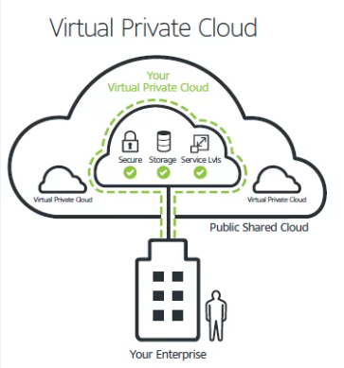
Strategic Networking for Robust Connectivity
Building the Cloud Backbone
Virtual Private Cloud (VPC):
Spans 2 zones in 1 region.
Provides an isolated networking environment for resources.
VPN Connection:
Utilizes a VPN connection.
lets us to connect our existing network to our
Compute Engine network via an IPsec connection
2 interfaces facilitate secure on-premise to cloud migration.
Cloud Router:
Facilitates dynamic route exchanges.
Enables efficient communication between on-premise and cloud environments.
Cloud DNS:
Manages domain names and resolves DNS queries.
Essential for domain management and resolution.
This foundational network infrastructure ensures a secure and efficient connection between on-premise and cloud resources, paving the way for seamless migration and dynamic routing exchanges within the Virtual Private Cloud.

Slide 7

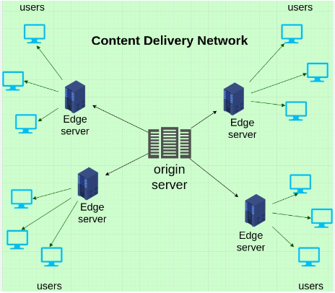
Empowering the Web Frontend
Managed Instance Group (MIG):
Web servers dynamically managed in a public subnet.
Ensures automatic scaling based on demand.
Cloud NAT (Network Address Translation):
Facilitates outbound internet access for web servers.
Enables secure and controlled communication.
Cloud Armor:
Web Application Firewall (WAF) protection.
Guards against web-based attacks, ensuring application security.
Google-managed SSL Certificates:
Provides secure communication between users and web servers.
Ensures data integrity and confidentiality.
Cloud CDN (Content Delivery Network):
Accelerates content delivery by caching static content.
Enhances performance by serving content from edge locations.
The key components used here is ensuring scalability, security, and optimized performance for the web servers.

Slide 8
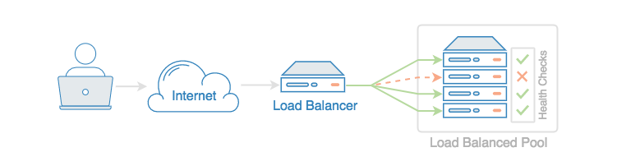
Efficient Traffic Distribution
HTTP Cloud Load Balancing (Layer 7):
Distributes incoming HTTP and HTTPS traffic to web servers.
Utilizes Layer 7 to intelligently route requests based on content.
Enhances application performance by directing users to the nearest healthy instance.
Benefits:
Scalability: Scales resources dynamically based on demand.
Global Reach: Provides a global anycast IP for low-latency access.
SSL Termination: Performs SSL termination for secure communication.
Internal Load Balancer:
Routes traffic to the backend application layer.
Facilitates smooth communication within the internal infrastructure.
Key Features:
Private IP Address: Assigns a private IP to the load balancer.
Regional Scoping: Functions within a specific region for internal traffic.
Backend Service Integration: Directs traffic to backend services.

Slide 9
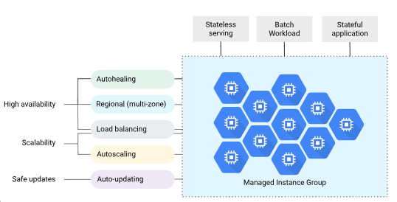
Empowering the Application Layer
Managed Instance Group (MIG):
Importance:
Scalability: MIG enables dynamic scaling of application servers based on traffic load.
High Availability: Distributes traffic across multiple instances, ensuring continuous service availability.
Fault Tolerance: Automatically replaces failed instances, minimizing downtime.
Effective Methods:
Autoscaling: MIG adjusts the number of instances based on demand, optimizing resource utilization.
Health Checks: Regular health checks ensure instances are responsive and available.
Rolling Updates: Facilitates seamless application updates without service interruption.

Slide 10
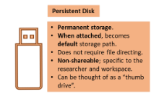
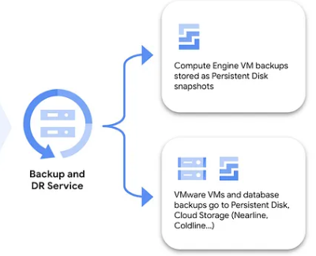
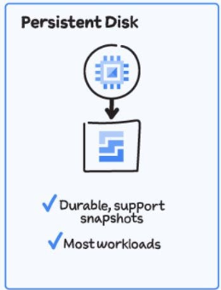
Empowering the Application Layer
Persistent Disks(Block Storage):
Importance:
Data Persistence: Ensures data durability and availability across instance restarts.
Scalable Storage: Provides reliable and scalable storage for application data.
Effective Methods:
Snapshots: Periodic snapshots for backup and recovery.
Regional Replication: Replicates data across multiple zones for high availability.
Performance Scaling: Adjusts disk performance based on application needs.

Slide 11
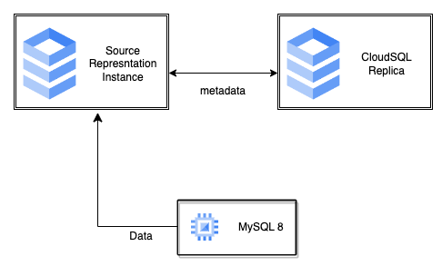
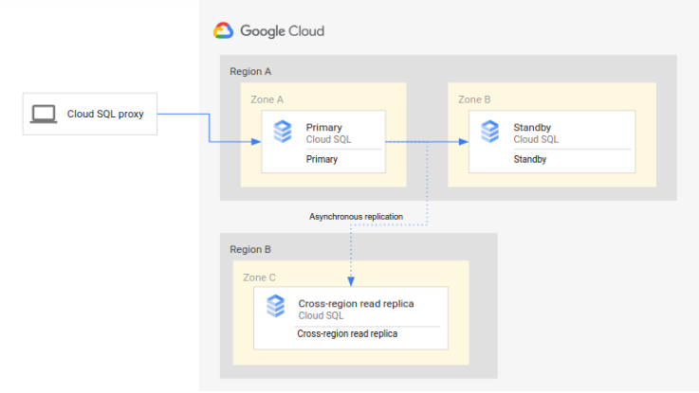
Ensuring Robust Database Management
Cloud SQL with Read Replication:
Importance:
High Availability: Utilizes read replication for redundancy and continuous service availability.
Scalability: Allows read replicas to handle read traffic, distributing the load.
Data Consistency: Ensures data consistency across replicas for reliability.
Effective Features:
Automated Backups: Regular automated backups for data protection.
Point-in-Time Recovery: Enables recovery to a specific point in time for data restoration.
Failover: Automatic failover to a replica in case of a primary instance failure.

Slide 12
Ensuring Robust Database Management
Cloud Storage for Backup and Restore:
Importance:
Data Backup: Provides a secure and scalable solution for backup storage.
Disaster Recovery: Ensures data recovery in case of database failure or data loss.
Cost-Effective Storage: Utilizes Cloud Storage for efficient and cost-effective backup operations.
Effective Usage:
Automated Backup Policies: Configures automated backup schedules.
Versioning: Leverages versioning to manage different versions of backups.
Regional Storage: Utilizes regional storage for redundancy and data durability.
Ensuring Data Integrity and Availability
This strategic use of Cloud SQL with read replication for high availability and Cloud Storage for efficient backup and restore operations in the Database Tier. These features contribute to data consistency, scalability, and robust disaster recovery.

Slide 13
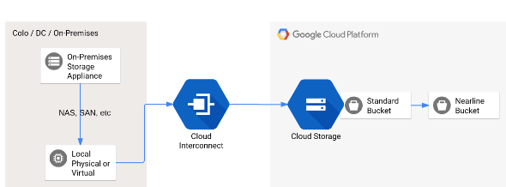
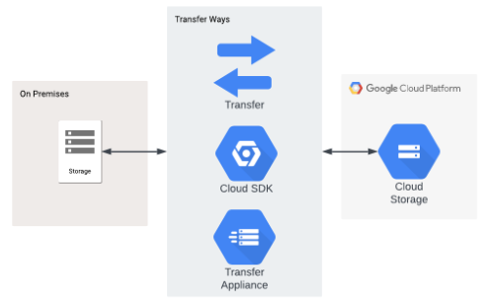
Cloud Storage for Backup and Restore

Slide 14
Safeguarding Data and Access
Cloud IAM (Identity and Access Management):
Importance:
Access Control: Manages and restricts access to resources based on user roles.
Least Privilege Principle: Ensures users have the minimum necessary permissions.
Identity Federation: Integrates with identity providers for secure user authentication.
Effective Usage:
Role-Based Access Control (RBAC): Assigns roles to users based on their responsibilities.
Fine-Grained Permissions: Configures precise permissions for specific resources.
Service Account Integration: Enhances security by using service accounts for applications.
Cloud Firewall Rules:
Importance:
Traffic Control: Defines rules for controlling incoming and outgoing traffic.
Network Segmentation: Segregates network resources for enhanced security.
DDoS Mitigation: Protects against Distributed Denial of Service (DDoS) attacks.
Effective Usage:
Rule Prioritization: Orders rules to ensure proper sequence execution.
IP Whitelisting/Blacklisting: Manages access based on specific IP addresses.
Logging and Monitoring: Monitors firewall activity for potential threats.

Slide 15
Safeguarding Data and Access
Encryption at Rest and in Transit using Key Management Services:
Importance:
Data Security: Ensures data confidentiality and integrity.
Regulatory Compliance: Meets encryption requirements for compliance standards.
Secure Communication: Encrypts data during transit for secure communication.
Effective Usage:
Key Rotation: Regularly rotates encryption keys for added security.
Integrated Key Management: Uses Key Management Services for centralized key management.
TLS/SSL Encryption: Implements encryption protocols for data in transit.
The critical security measures implemented, including Cloud IAM for access control, Cloud Firewall Rules for traffic control, and Encryption at rest and in transit using Key Management Services. These measures collectively contribute to a robust security framework for the architecture.

Slide 16
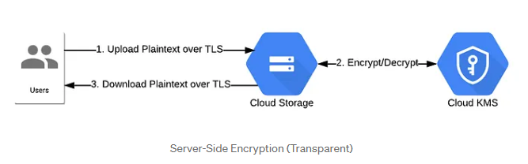
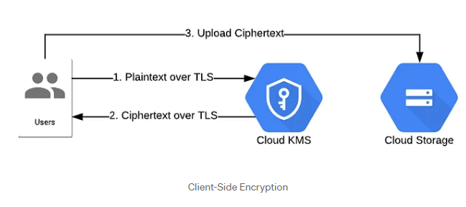
Key Management Services

Slide 17
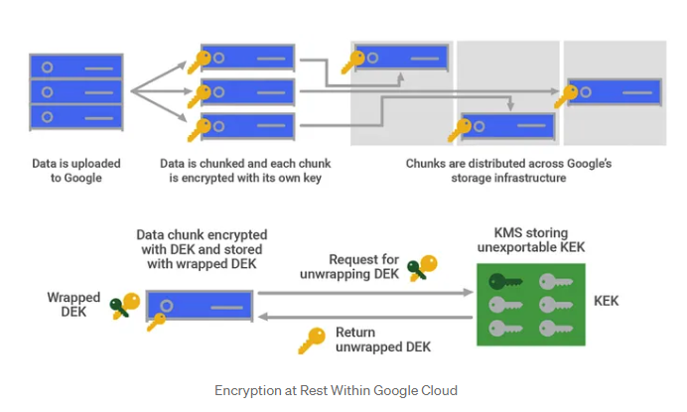
Encryption at Rest

Slide 18
Optimizing Storage and Enhancing Performance
Cloud Storage for Static Content:
Importance:
Scalable Object Storage: Provides scalable and reliable storage for static content.
CDN Integration: Serves as the source for static content delivery through the CDN.
Cost-Effective Archiving: Offers cost-effective archival of large volumes of data.
Effective Usage:
Multi-Regional Storage: Leverages multi-regional storage for content distribution.
Access Control Policies: Defines access policies to restrict content access.
Versioning: Manages different versions of static content for rollbacks.
Memorystore Redis for Caching:
Importance:
In-Memory Data Store: Provides a high-performance, in-memory data caching solution.
Improved Application Response: Accelerates application response times by caching frequently accessed data.
Scalability: Scales horizontally to handle increasing caching demands.
Effective Usage:
Data TTL (Time-to-Live): Configures TTL for automatic expiration of cached data.
Replication: Implements replication for data redundancy and high availability.
Integration with CDN: Enhances content delivery by serving cached data from Redis.

Slide 19
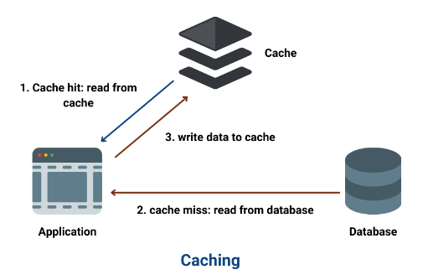
Cloud Memorystore for Redis

Slide 20
Monitoring & Logging
Cloud Monitoring:
Importance:
Performance Insights: Monitors system and application performance in real-time.
Alerting System: Provides proactive alerts for potential issues.
Resource Utilization: Tracks resource usage and identifies bottlenecks.
Effective Usage:
Custom Dashboards: Creates customized dashboards for specific metrics.
Automated Monitoring: Sets up automated monitoring for key performance indicators.
Integration with Other Services: Integrates with various GCP services for comprehensive monitoring.

Slide 21
Monitoring & Logging
Cloud Logging:
Importance:
Centralized Log Management: Aggregates logs from various services for centralized visibility.
Security Analysis: Assists in security analysis by monitoring system and application logs.
Audit Trails: Maintains detailed audit trails for compliance and troubleshooting.
Effective Usage:
Advanced Querying: Utilizes advanced querying for specific log data extraction.
Log Export: Exports logs to external storage or analysis tools for further examination.
Integration with Monitoring: Correlates logs with monitoring data for comprehensive analysis.

Slide 22
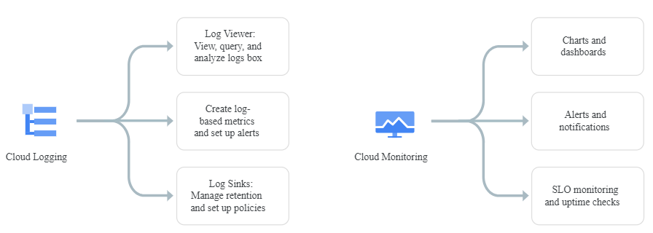
Monitoring & Logging Features

Slide 23
Conclusion
Design Success: Aligning with Customer Vision
Recap of Key Design Elements:
Scalability: Dynamic scaling through Managed Instance Groups and Cloud SQL read replication.
Availability: Redundancy achieved with load balancing, multiple zones, and read replicas.
Security: Robust security measures, including IAM, Firewall Rules, and Encryption.
Performance: Optimized performance with CDN, Memorystore Redis, and monitoring tools.
Reliability: Data persistence ensured by Persistent Disks and automated backups.
Maintainability: Efficient operations with centralized monitoring and logging.
Emphasis on Alignment with Customer Requirements:
Rapid Growth Support: Scalable architecture prepares for significant visitor volume.
High Availability: Redundancy and load balancing minimize points of failure.
Disaster Recovery: Read replicas, backups, and regional storage ensure recoverability.
Performance Optimization: CDN, Memorystore Redis, and monitoring tools enhance performance.
Data Security: Encryption at rest and in transit ensures data integrity and confidentiality.
Bulk Uploads: Cloud Storage supports bulk uploads for customer information.
Maintainability: Centralized monitoring and logging facilitate efficient operations.
Operability & Accessibility: Secure access with IAM and Firewall Rules for on-premise to cloud connectivity.

Slide 24
Future Enhancements
Continued Innovation and Growth
Scalability:
Explore serverless computing options for even more flexible and efficient scaling.
Investigate microservices architecture for modular and independent scaling.
Security:
Implement advanced threat detection tools for real-time security monitoring.
Evaluate the use of zero-trust security principles for enhanced protection.
Performance Optimization:
Research and adopt emerging technologies for further performance improvements.
Conduct periodic performance assessments to identify and address bottlenecks.
Operational Efficiency:
Integrate AI/ML-driven automation for predictive maintenance and issue resolution.
Explore Infrastructure as Code (IaC) for streamlined and version-controlled deployments.

Slide 25
Future Enhancements
Data Management:
Investigate the use of BigQuery for advanced analytics and data processing.
Implement data lifecycle management strategies for efficient data handling.
Cost Optimization:
Regularly review and optimize resource usage to minimize costs.
Explore the use of committed use discounts and custom machine types for cost-efficiency.
Geographical Expansion:
Evaluate the need for additional regions to further distribute traffic.
Consider multi-cloud or hybrid cloud strategies for increased redundancy.

